Slide 1
Implimentation of I2C Protocol to control Three Sub-Microcontroller
-:Group Members:-
Shubham P. Gothale (1611MT13)

Slide 2
Component Used
Arduino Uno (as a Master) : 1
Arduino Nano (Slave) :2
IC LM7806 : 3
Jumper Wires

Slide 3
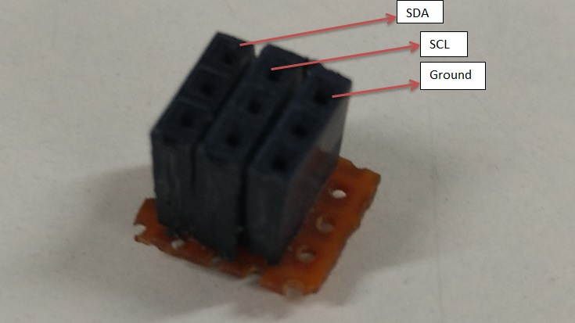
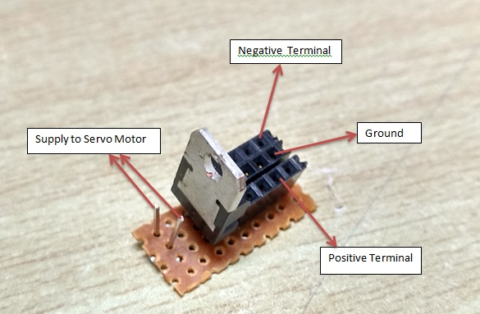
Module Used
1. Communication Module
2. Power Module

Slide 4
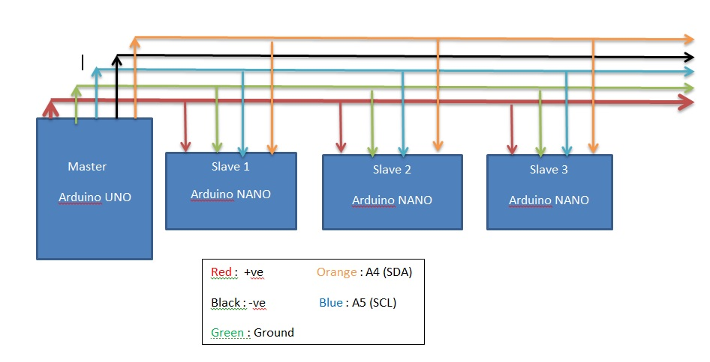
I2C Protocol Setup

Slide 5
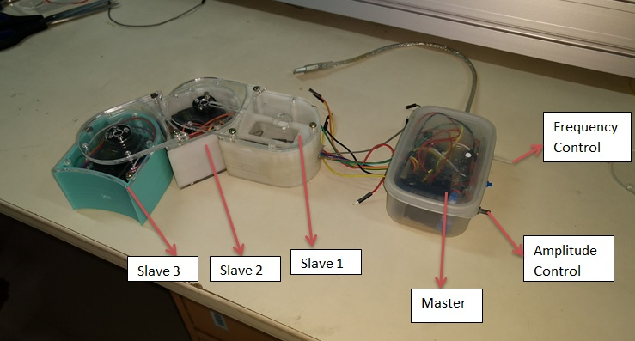
implementation of Setup

Slide 6
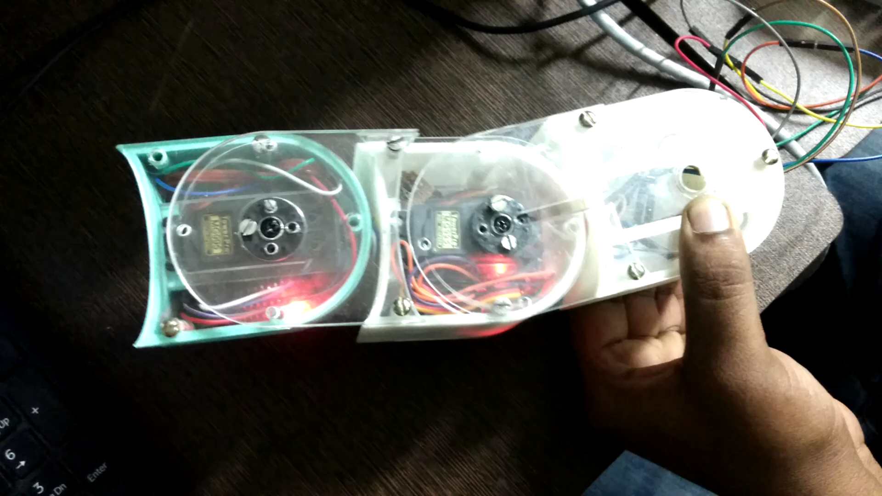
Working

Slide 7
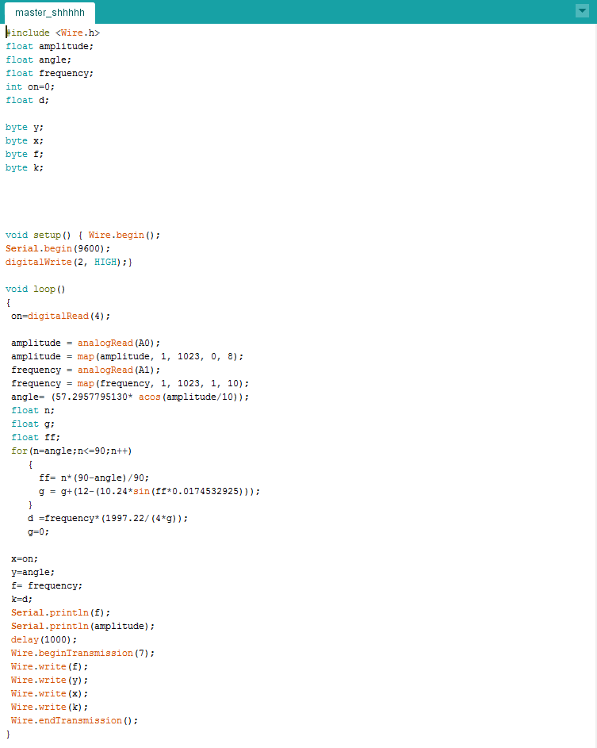
Coding (Master Programming)
First we generate all the parameter of sinusoidal motion
Amplitude(angle):-Y
Frequency :-F/10
Delay :- k
Activation:- X
Angle Calculation
angle= (57.2957795130* acos(amplitude/10));
Delay Calculation
for(n=angle;n<=90;n++)
{
ff= n*(90-angle)/90;
g = g+(12-(10.24*sin(ff*0.0174532925)));
}
d =frequency*(1997.22/(4*g));

Slide 8
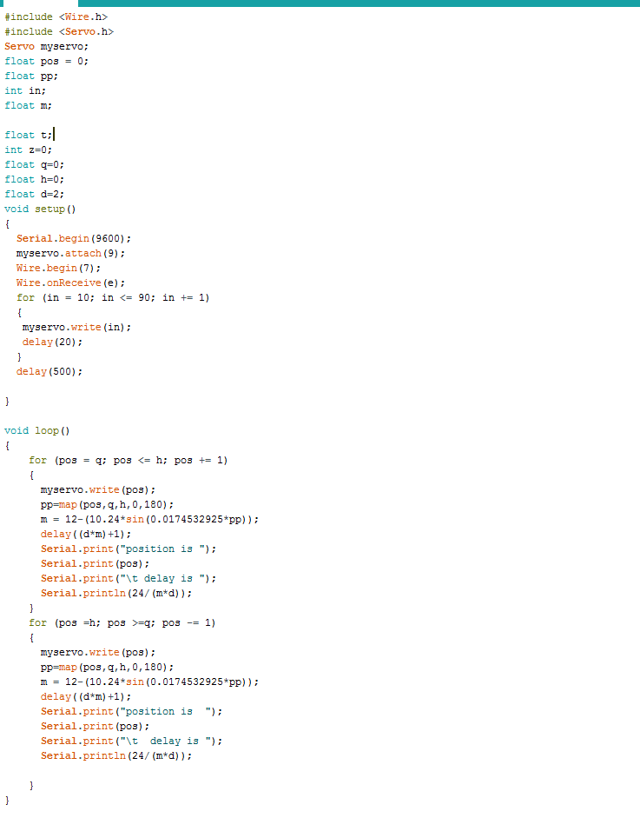
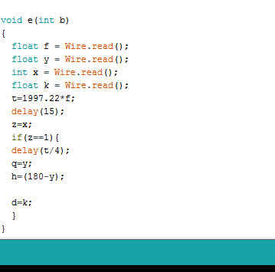
Coding (Slave Programming)
Time Period Calculation :-
t=1997.22*f
Position Control Delay (m):-
pp=map(pos,q,h,0,180);
m = 12-(10.24*sin(0.0174532925*pp));

Slide 9
Plots(Without Mapping)
x-axis :- Delay in each step
y- axis :- position of servo motor
Frequency:- 0.5 (max)
Amplitude:-8(1 min, 10 max)
for (pos = q; pos <= h; pos += 1)
{
myservo.write(pos);
m = 12-(10.24*sin(0.0174532925*pos));
delay((d*m)+1);
Serial.println(24/(m*d));
}
Frequency:- 0.167
Amplitude:-4

Slide 10
Plots (With Mapping)
x-axis :- Delay in each step
y- axis :- position of servo motor
Frequency:- 0.5 (max)
Amplitude:-8(1 min, 10 max)
for (pos = q; pos <= h; pos += 1)
{
myservo.write(pos);
pp= map(pos,q,h,0,180);
m = 12-(10.24*sin(0.0174532925*pp));
delay((d*m)+1);
Serial.println(24/(m*d));
}
Frequency:- 0.167
Amplitude:-4

Slide 11
Conclusion
Desired behavior of the I2C bus controller agree.
Reduce the number of wire required.
Simple to Design and Implement.
I2C bus can communicate with slow devices and can also use high speed modes to transfer large amounts of data.

Slide 12
Limitations
I2C bus is shared by multiple slave devices, if any one of these slaves misbehave the bus will be stalled. No further communication will take place.
I2C master protocol is straightforward and easy to implement, but that is not the case if you want to implement the protocol in slave devices.
At a time, data is transmitted only in one direction.

Slide 13
Future Scope
We will implement it in Underwater surveillance.
Interfacing of different I2C components like ADC/DAC, RTC & EEPROM with Microcontroller through I2C bus at a time and the result to be displayed on LCD.

Slide 14
References
https://www.arduino.cc/en/Reference/Wire
https://circuits.io/
https://www.eeweb.com/blog/nxp/P10/(Fig1)
The I2C -Bus specifications version 2.1 January 2000 http://www.semiconductors.philips.com/buses/i2c
I2C bus Inter Integrated Circuits bus by Philips Semiconductors.

Slide 15
THANK YOU

